Slide 1
Opened eyes, burning hearts
Luke 24:31-35

Slide 2
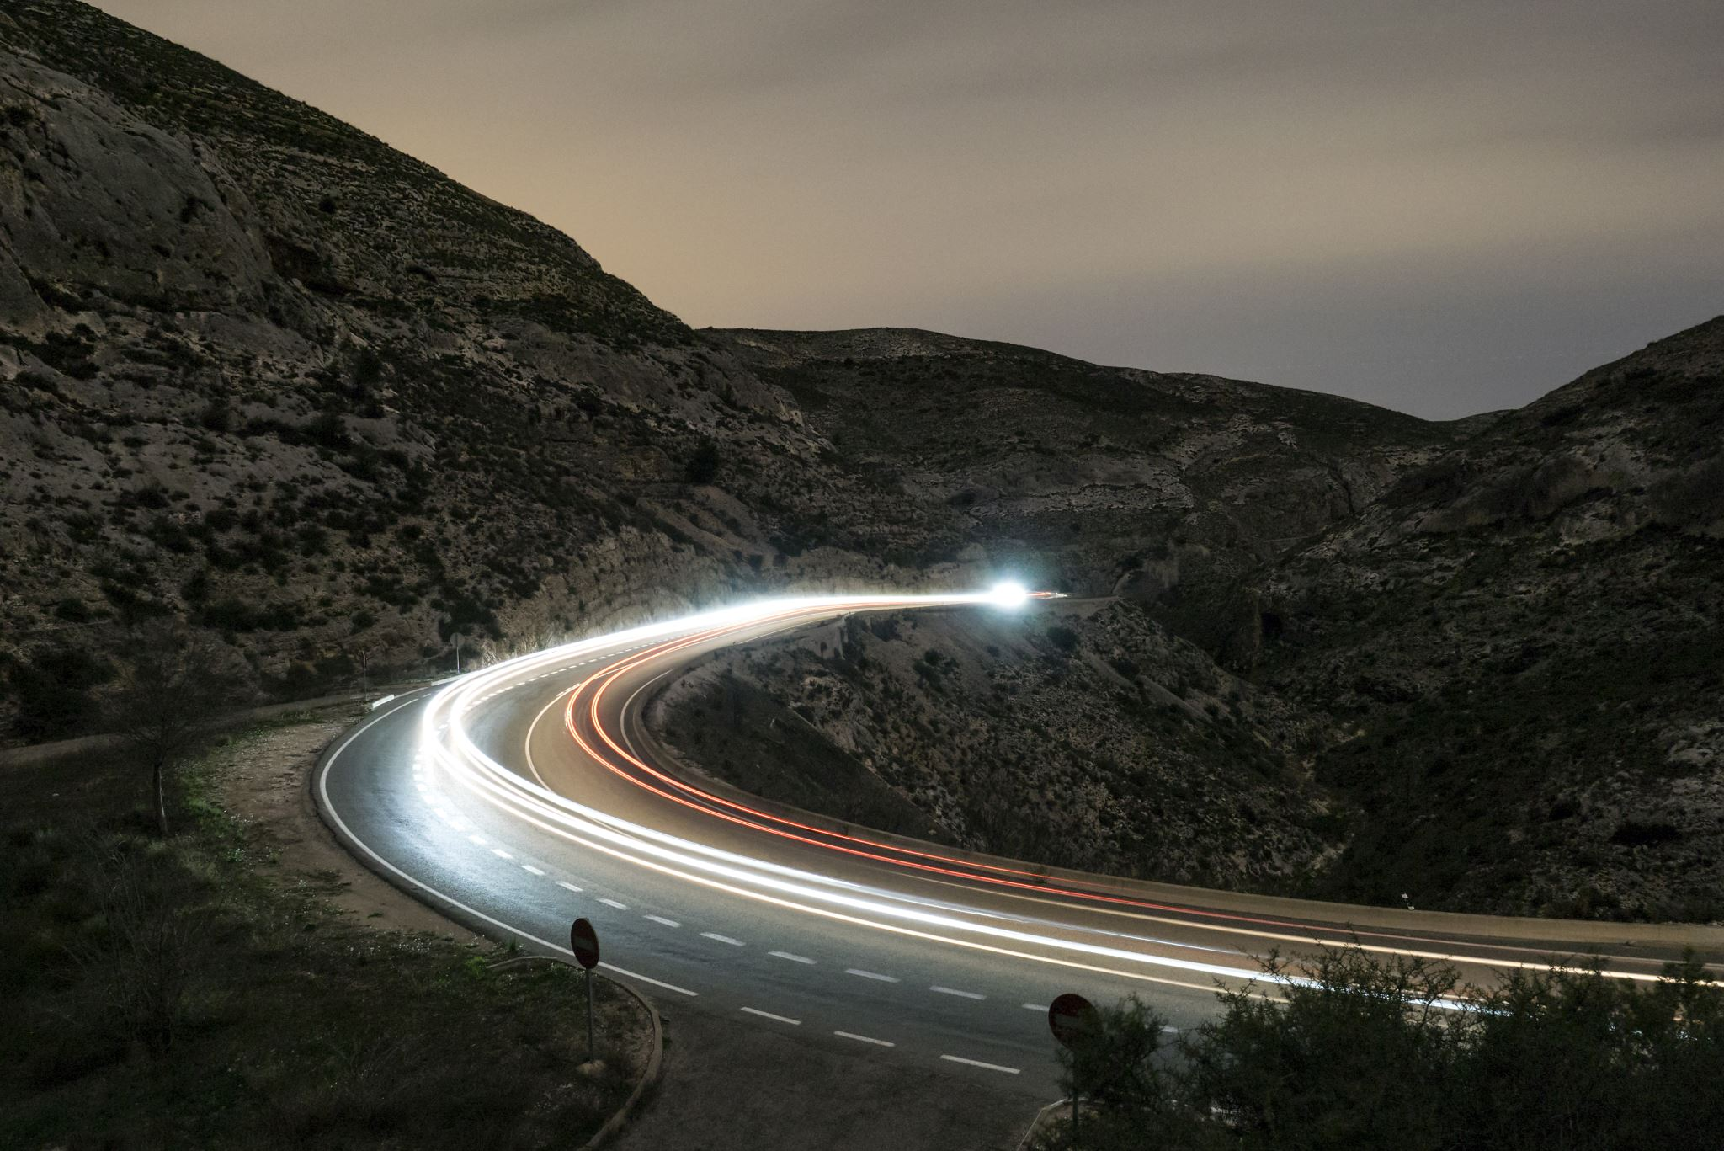
Then their eyes were opened and they recognized Him, and He disappeared from their sight. They asked each other, 'Were not our hearts burning within us while He talked with us on the road and opened the Scriptures to us?' They got up and returned at once to Jerusalem. There they found the Eleven and those with them, assembled together and saying, 'It is true! The Lord has risen and has appeared to Simon.' Then the two told what had happened on the way, and how Jesus was recognized by them when He broke the bread.” Lk 24:31-35

Slide 3
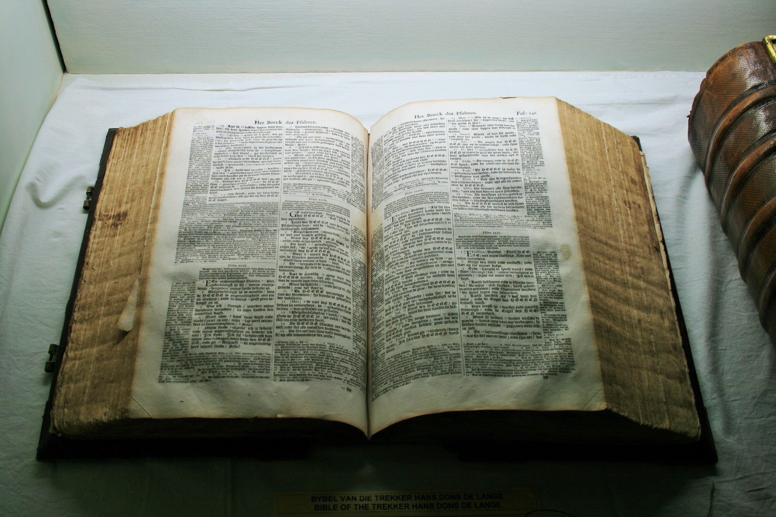
“A Bible that's falling apart usually belongs to someone who isn’t.”
~ Charles Spurgeon

Slide 4
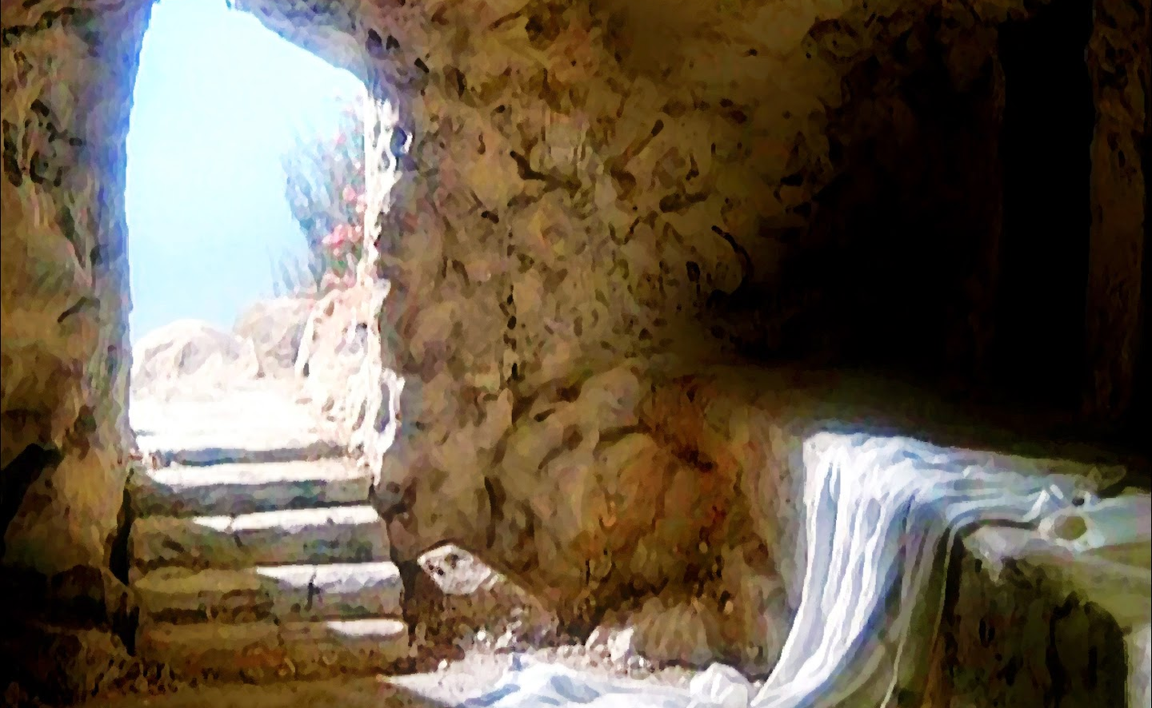
The tomb is empty
This Photo by Unknown Author is licensed under CC BY-SA-NC

Slide 5
main points
Recognizing the Resurrected Christ
Revelation of Truth through Christ
Reformation of Hearts by Christ.

Slide 6

The road to emmaus

Slide 7
Do not forget to show hospitality to strangers, for by so doing some people have shown hospitality to angels without knowing it.
Heb. 13:2

Slide 8

how did they recognize Jesus?
They sat down to eat
Jesus breaks the bread
**Eyes are opened in fellowship with Jesus

Slide 9
Recognizing the Resurrected Christ
Recognition is an act of:
Seeing
Understanding
Acknowledging

Slide 10
God, you are my God. I want to follow you. My whole being thirsts for you, like a man in a dry, empty land where there is no water. ² I have seen you in the Temple. I have seen your strength and glory. ³ Your love is better than life. I will praise you. ⁴ I will praise you as long as I live. I will lift up my hands in prayer to your name. ⁵ I will be content as if I had eaten the best foods. My lips will sing. My mouth will praise you. ⁶ I remember you while I’m lying in bed. I think about you through the night. Psalm 63:1-8 ICB

Slide 11
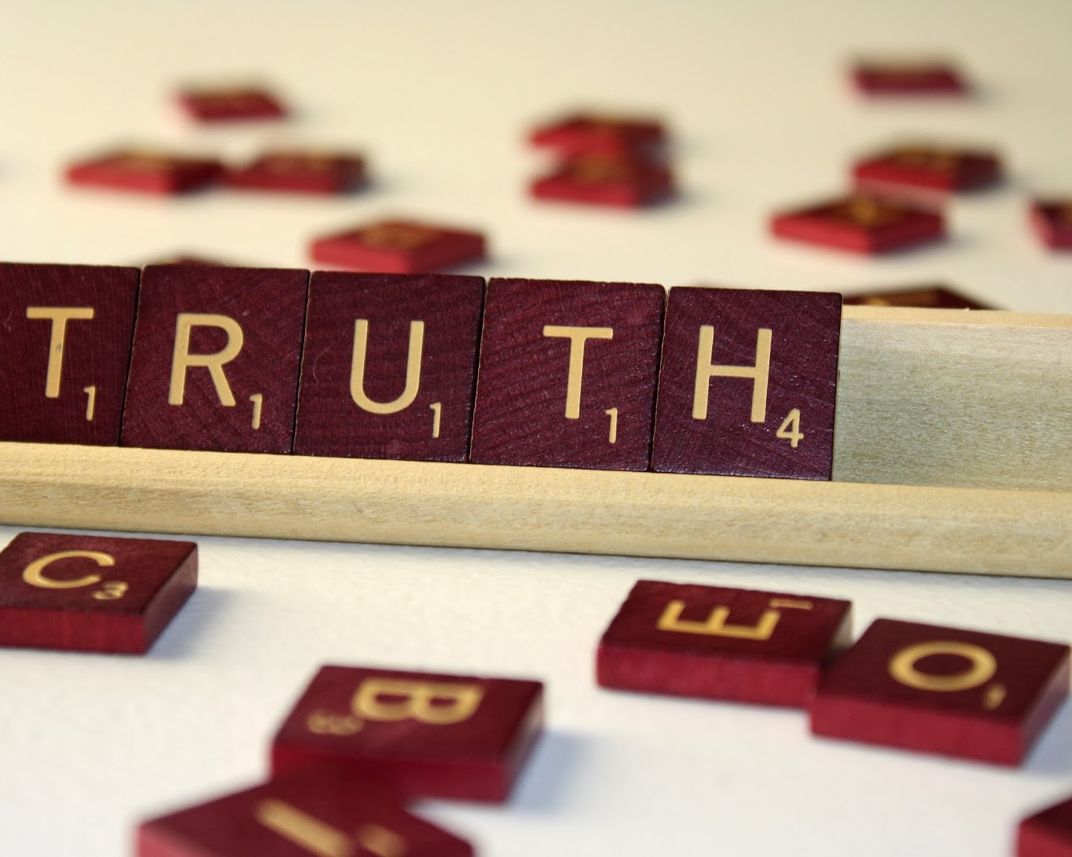
The Gospel’s truth creates a burning within us
It’s a spiritual awakening.
This Photo by Unknown Author is licensed under CC BY-SA-NC

Slide 12
Hebrews 4:12, 13
¹² God’s word is alive and working. It is sharper than a sword sharpened on both sides. It cuts all the way into us, where the soul and the spirit are joined. It cuts to the center of our joints and our bones. And God’s word judges the thoughts and feelings in our hearts. ¹³ Nothing in all the world can be hidden from God. Everything is clear and lies open before him. And to him we must explain the way we have lived.

Slide 13

“Opened” the scriptures
(dienoigēsan)
Unveiling
Revealing
Making clear
Acts 16:14
2 Corinthians 3:14

Slide 14
Reformation of hearts by christ
Our hearts are not just vessels of emotion, but vessels of truth
Our hearts are not just containers of love, but containers of God's love.
It's in this recognition that we find the first seeds of transformation.
John 3:16

Slide 15

"To love at all is to be vulnerable. Love anything and your heart will be wrung and possibly broken… To love is to be vulnerable.”
C.S. Lewis

